Slide 1

Car price prediction
Machine Learning Project

Slide 2
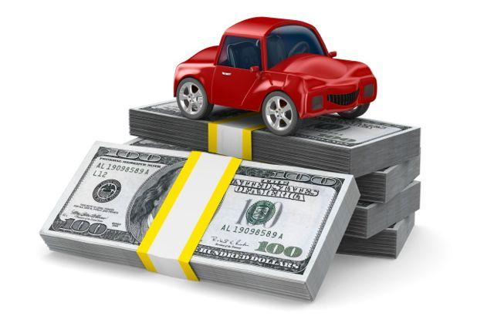
Car price prediction
Batch : Data Associate
Represend By
Aaditi P. Yeole
Nikita A. Mali
Vaishnavi N. Chaudhari

Slide 3
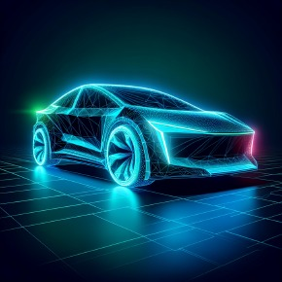
Contents
Introduction
Libraries
Dataset and tools
ALGORITHM
Advantages
Disadvantages
CSV FILE
Tablue
REFERENCE

Slide 4

INTRODUCTION
In the automotive industry, accurately predicting the price of a used car is a complex task due to the variety of factors that influence a car's value. These factors include the make and model of the car, its age, mileage, condition, location, and additional features. A machine learning model can help in making more accurate predictions by analyzing large datasets of car listings and sales. Car price prediction using machine learning is a valuable tool that can streamline the buying and selling process in the used car market. By leveraging historical data and advanced algorithms, we can provide more accurate price estimates, benefiting both sellers and buyers.

Slide 5

Libraries
import pandas as pd
import matplotlib.pyplot as plt
import seaborn as sns
from sklearn.preprocessing import Standardscaler
from sklearn.model_selection import train_test_split
from sklearn.linear_model import LinearRegression

Slide 6

Dataset And Tools
Dataset from the :- Kaggle.com
Tool used:-
Python
Pandas : for data analysis
Numpy : for numeric calculation
Matplotlib : for data visualization
Seaborn for data visualization
Sklearn : for making statistical graphics

Slide 7
Algorithm
Linear regression : Linear Regression in Machine Learning analysis is important for evaluating data and establishing a definite relationship between two or more variables.
Train test split :is a model validation process that allows you to check how your model would perform with a new data set. The train validation test split helps assess how well a machine learning model will generalize to new, unseen data.
Ridge regression:ridge regression is a linear regression method that adds a bias to reduce overfitting and improve prediction accurancy
Lasso regression:[least absolute shrinkage and slection operator]

Slide 8
KNNeighborsRegressor: kneighborsregression the predict continuous
values , knn takes the mean of the nearest k neighbors
SVR: Support Vector Regression is a supervised learning algorithm that is used to predict discrete values.The basic idea behind SVR is to find the best fit line. In SVR, the best fit line is the hyperplane that has the maximum number of points.

Slide 9
Uses
For Car Dealerships and Online Marketplaces
Pricing Strategy: Dealerships can use predictive models to set competitive and fair prices for their inventory based on market trends, car specifications, and historical sales data.
Inventory Management: Predicting the value of used cars can help in managing inventory more effectively by identifying vehicles that may depreciate faster.
For Consumers
Informed Purchasing Decisions: Consumers can use car price prediction models to get an estimate of a fair price for a car, helping them negotiate better deals and avoid overpaying.
Budget Planning: Prospective car buyers can use price predictions to determine the affordability of different car options within their budget.

Slide 10
Advantages of car price preductions
Practical Application: Car prediction projects have real-world applications, such as helping buyers make informed decisions, assisting sellers in setting competitive prices, and enabling insurers to assess risk.
Diverse Data Sources: Car-related data is abundant and can be collected from various sources, such as online marketplaces, manufacturer specifications, and customer reviews
Disadvantages of car price preductions
1.Data Quality: Car-related data may suffer from inconsistencies, missing values, and inaccuracies, which can affect the model's performance.
2.Changing Market Conditions: The car market is dynamic, with changing trends, new models, and fluctuating prices. A model trained on past data may not accurately predict future prices.

Slide 11
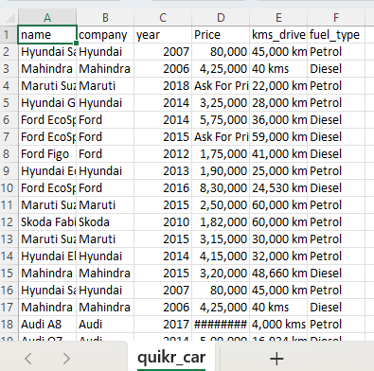
Csv file : Car price prediction (quikr_car.csv )

Slide 12
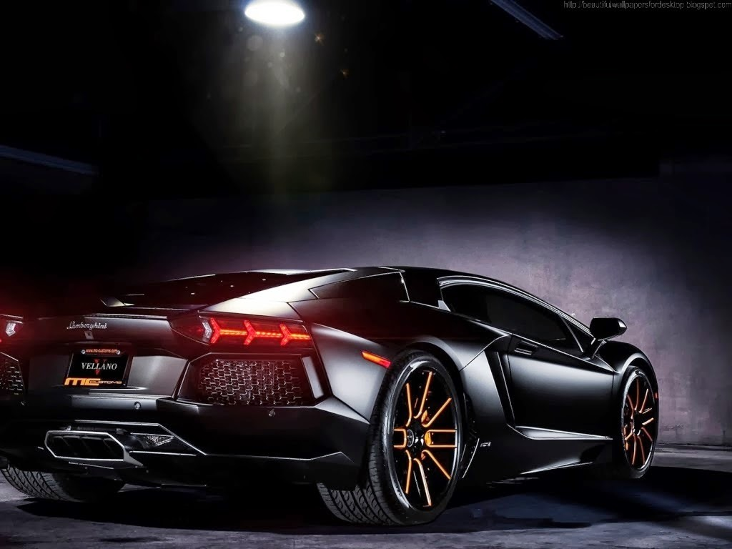
REFERENCE
Kaggle link : www.kaggle.com
www.github.com

Slide 13

Thank You …

